Slide 1
Adaptive Boosting
Dinesh C

Slide 2
AdaBoost Regressor
It is a powerful ensemble learning technique.
It combines multiple weak classifiers to create a strong classifier
It has 8 steps as below
Sample weight creation
Stump creation
Stump selection
Calculate total error
Calculate amount of say or Performance say
Update weight
Normalize the weights
New sample formation

Slide 3
Flowchart
Start
Initialize Sample Weight
Base Classifier Selection
Calculating Base Classifier Weights
Sample Weights Update
Reaching the iteration threshold
No
Yes
Obtain the Final Model
End

Slide 4
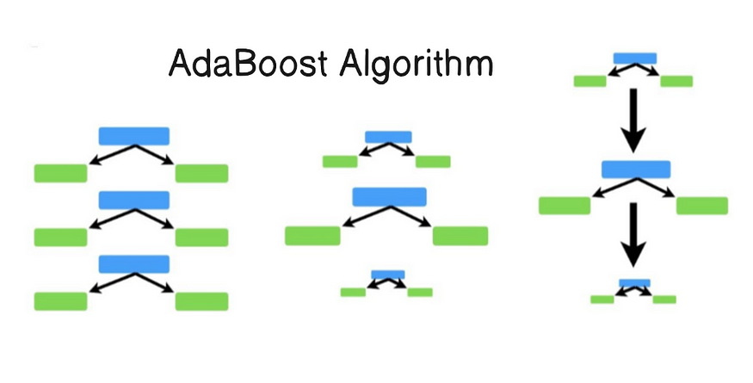
Root node with leaf node in only one depth is know as STUMPS
Calculate the Entropy for each stump and select the stump which has minimum Entropy value

Slide 5
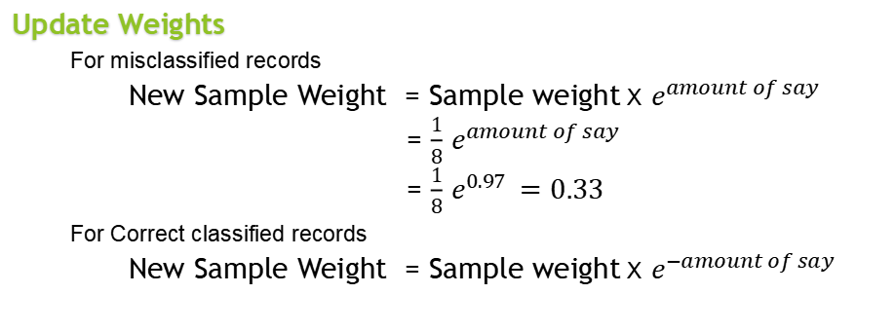
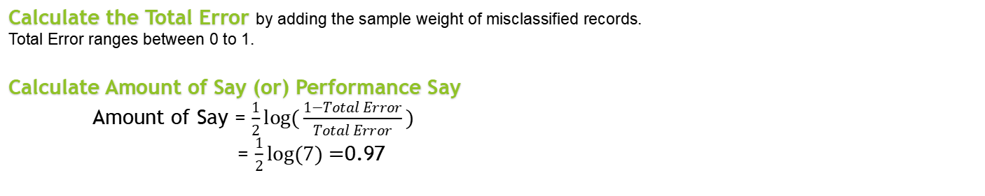
Calculate the Total Error by adding the sample weight of misclassified records.
Total Error ranges between 0 to 1.
Calculate Amount of Say (or) Performance Say
Amount of Say = $\frac{1}{2}log⁡(\frac{1−Total Error}{Total Error})$
= $\frac{1}{2}log⁡(7)=$0.97
Update Weights
For misclassified records
New Sample Weight = Sample weight X $e^{amount of say}$
= $\frac{1}{8}$ $e^{amount of say}$
= $\frac{1}{8}$ $e^{0.97 }=0.33$
For Correct classified records
New Sample Weight = Sample weight X $e^{−amount of say}$
F1 | F2 | F3 | Output |  | Sample Weight |  | Updated Weights
12 | 3 | 23 | Yes |  | 1/8 |  | 0.05
23 | 5 | 45 | Yes |  | 1/8 |  | 0.05
34 | 3 | 43 | No |  | 1/8 |  | 0.05
21 | 4 | 65 | Yes |  | 1/8 |  | 0.33
45 | 5 | 34 | No |  | 1/8 |  | 0.05
12 | 2 | 23 | No |  | 1/8 |  | 0.05
34 | 5 | 43 | Yes |  | 1/8 |  | 0.05
16 | 6 | 45 | Yes |  | 1/8 |  | 0.05

Slide 6
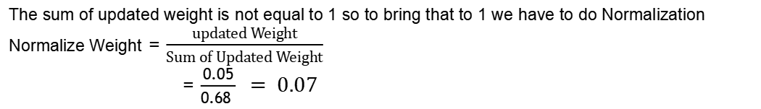
Normalize Weight
The sum of updated weight is not equal to 1 so to bring that to 1 we have to do Normalization
Normalize Weight = $\frac{updated Weight}{Sum of Updated Weight}$
= $\frac{0.05}{0.68 } = 0.07$
F1 | F2 | F3 | Output |  | Sample Weight |  | Updated Weights |  | Normalized Weight
12 | 3 | 23 | Yes |  | 1/8 |  | 0.05 |  | 0.07
23 | 5 | 45 | Yes |  | 1/8 |  | 0.05 |  | 0.07
34 | 3 | 43 | No |  | 1/8 |  | 0.05 |  | 0.07
21 | 4 | 65 | Yes |  | 1/8 |  | 0.33 |  | 0.49
45 | 5 | 34 | No |  | 1/8 |  | 0.05 |  | 0.07
12 | 2 | 23 | No |  | 1/8 |  | 0.05 |  | 0.07
34 | 5 | 43 | Yes |  | 1/8 |  | 0.05 |  | 0.07
16 | 6 | 45 | Yes |  | 1/8 |  | 0.05 |  | 0.07
New sample formation
To get new random samples it will reorder based on bucket values and frame new dataset
After sample formation it starts from step 2
F1 | F2 | F3 | Output |  | Sample Weight |  | Buckets |  | F1 | F2 | F3 | Output |  | Sample Weight
12 | 3 | 23 | Yes |  | 0.07 |  | 0 - 0.07 |  | 34 | 3 | 43 | No |  | 0.07
23 | 5 | 45 | Yes |  | 0.07 |  | 0.07 - 0.14 |  | 23 | 5 | 45 | Yes |  | 0.07
34 | 3 | 43 | No |  | 0.07 |  | 0.14 - 0.21 |  | 12 | 3 | 23 | Yes |  | 0.07
21 | 4 | 65 | Yes |  | 0.49 |  | 0.21 - 0.70 |  | 34 | 5 | 43 | Yes |  | 0.07
45 | 5 | 34 | No |  | 0.07 |  | 0.70 - 0.77 |  | 16 | 6 | 45 | Yes |  | 0.07
12 | 2 | 23 | No |  | 0.07 |  | 0.77 - 0.84 |  | 12 | 2 | 23 | No |  | 0.07
34 | 5 | 43 | Yes |  | 0.07 |  | 0.84 - 0.93 |  | 45 | 5 | 34 | No |  | 0.07
16 | 6 | 45 | Yes |  | 0.07 |  | 0.93 - 1 |  | 21 | 4 | 65 | Yes |  | 0.49

